Slide 1
Stevenson Middle School
History Fair
2013-14

Slide 2
What’s so great about History Fair?
YOU choose your own topic!
YOU conduct research based on your interests!
YOU develop your own argument!
YOU choose the type of project you will create!

Slide 3
History Fair
Where the student is the historian…
Investigate a topic based on your interests.
Research primary and secondary sources, analyze and synthesize the sources, and develop your own argument.
Produce a project to communicate your work which is appreciated and judged by school and community volunteers.

Slide 4
History Fair Project Categories:
Exhibit (individual -or- small group*)
Documentary (individual -or- small group*)
Performance (individual -or- small group*)
Website (individual -or- small group*)
Research Paper (individual ONLY)
*Small group = 2 - 3 students MAX! and they must be in your class

Slide 5
What is a Historical Exhibit?
Presents information about an event, person, place, or idea from the past by physically displaying documents, images, or objects.
We often see exhibits at museums, historic sites, park visitor centers, classrooms, etc..
You will tell the story of your research through historic photographs, maps, drawings or other interesting objects.

Slide 6
Important Exhibit Rules:
  Must be no larger than:
    40 inches wide, 30 inches deep, and 6 feet high.
  Media devices (DVD players, computers, etc.) are allowed, but runtime is limited to 3 minutes.
  500-word limit on student created text.

Slide 7
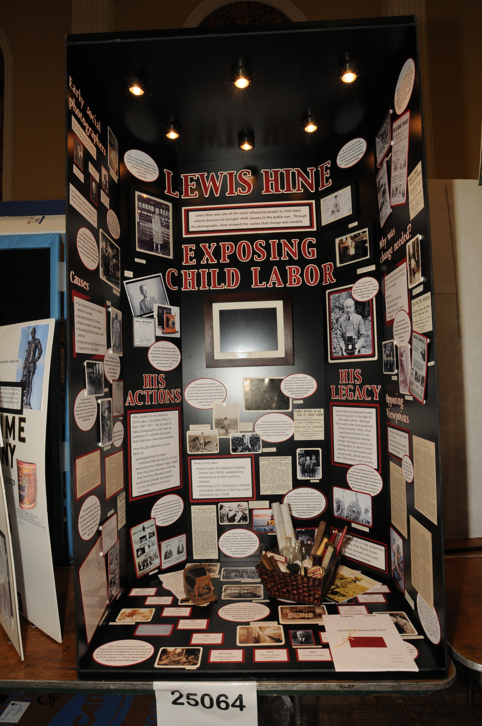

Slide 8
What is a Historical Documentary?
Presents information about an event, person, place or idea from the past through a 10-minute presentation:
  showcases documents, images, photographs, and actual footage of the topic you are researching.
Your documentary needs both primary and secondary research. But, can also be an original production.

Slide 9
Important Documentary Rules:
  Must NOT exceed 10 minutes in length.
    Note: You will be given 5 minutes to set-up & 5 minutes to tear-down project.
  Students MUST do ALL of the following:
    Narration and/or Voice-over
    Run camera equipment
    Editing

Slide 10
An example of a Historical Documentary:
http://www.nhd.org/CategoryDocumentary.htm
http://www.nhd.org/CategoryDocumentary.htm

Slide 11
What is a Historical Performance?
A live, dramatic presentation of the historical significance of your topic:
  You may perform individually or as part of a group.
Should be a scripted portrayal based on research of your chosen topic (with a thesis statement, supporting statements, and a conclusion).
Your performance should have dramatic appeal, but not at the expense of historical information.

Slide 12
Important Performance Rules:
  Must NOT exceed 10 minutes in length.
    Note: You will be given 5 minutes to set-up & 5 minutes to tear-down project.
  Media devices are allowed.
  Costumes may be purchased or produced for you but, design selection must be your own.
  May have some help with set construction.

Slide 13
Historical Performance Example:
http://www.nhd.org/CategoryPerformance.htm

Slide 14
What is a Historical Website?
A collection of web pages, interconnected with hyperlinks, that presents primary and secondary sources, interactive multimedia, and historical analysis.
An accumulation of research and argument that incorporates textual and non-textual (photographs, maps, music, etc.) description, interpretation, and multimedia sources to engage and inform viewers about your chosen historical topic.

Slide 15
Important Website Rules:
  No more than 1,200 student-composed words.
  Site may NOT exceed 100MB of file space.
  NO limit on the number of multimedia clips used:
    Note: No clip can be longer than 45 seconds.

Slide 16
Examples of Historical Websites:
Valley Forge and the Transformation of the Continental Army (Stevenson web site Regional 1st place winner, state participant)
http://43872311.nhd.weebly.com/
Debate and Diplomacy: Panama Canal Treaties
http://15787595.nhd.weebly.com
A Debate Distilled: The Consequences of Prohibition and the Volstead Act http://33212321.nhd.weebly.com

Slide 17
What is a Historical Paper?
Presents information and analyzes an event, person, place or idea from the past in writing.
Although you might attach a map, chart or photograph that you refer to in your paper, you will rely mainly on words.

Slide 18
Important Paper Rules:
  Length:
    No less than 1,500 words
    No more than 2,500
    Word count does not include notes, bibliography, illustration captions, or supplemental/appendix material
  Citations (footnotes, endnotes, or internal documentation) are required.

Slide 19

This year’s History Fair theme:
Rights and Responsibilities

Slide 20
But how do I choose a topic that relates to that theme?!?!
Topics for research are everywhere! Think about a time in history or individuals or events that are interesting to you.
Start a list:
  Use books, newspapers, etc. to add to your list.
Talk with relatives, neighbors, or people you know who have lived through a particular time in history that interests you and add more ideas.

Slide 21
When making your list, ask yourself…
Why are these topics important?
How are these topics significant in history?
  Relate it to History Fair theme - “Rights and Responsibilities”
How did these topics develop over time?
How did these topics influence history?

Slide 22
After you have created your list…
Go back through the list and circle the ideas that best connect with this year’s theme.
  Rights and Responsibilites
Look over your choices and select 1 to begin researching.
Keep your list because you might need it again.

Slide 23


I’m so excited about the topic I’ve picked!
Now what?

Slide 24

Research? Hmm…
What possible sources of information can I use?
What are the best sources for my project?
Have I used a variety of resources?

Slide 25
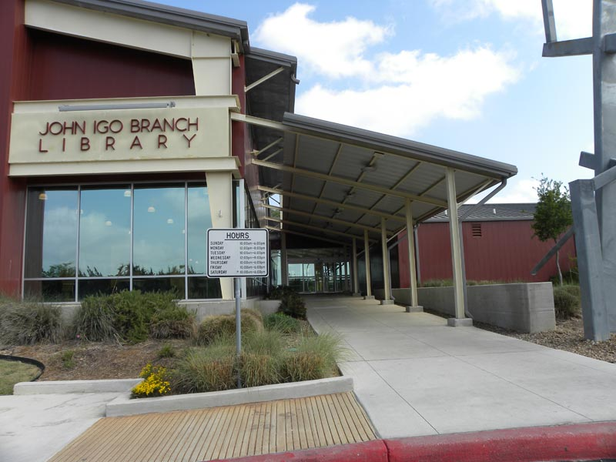
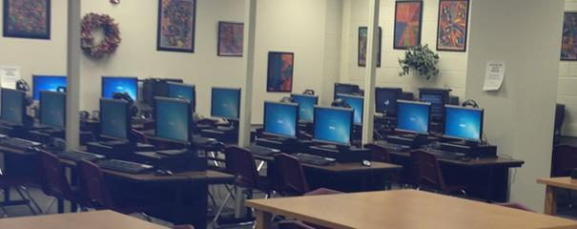
Help…
Where could I find these resources?
Do I know how to use them?
Igo Public Library
Stevenson Middle
School Library
Notes:
25

Slide 26
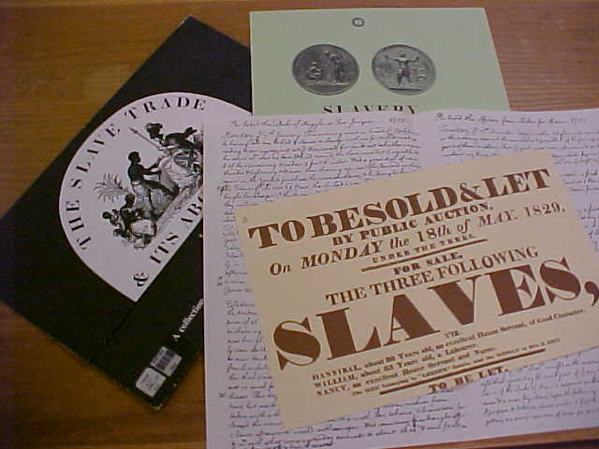
Primary Sources
Diaries
Journals
Speeches
Interviews
  A primary source is actual material written or produced in the time period students are investigating.
Notes:
26

Slide 27
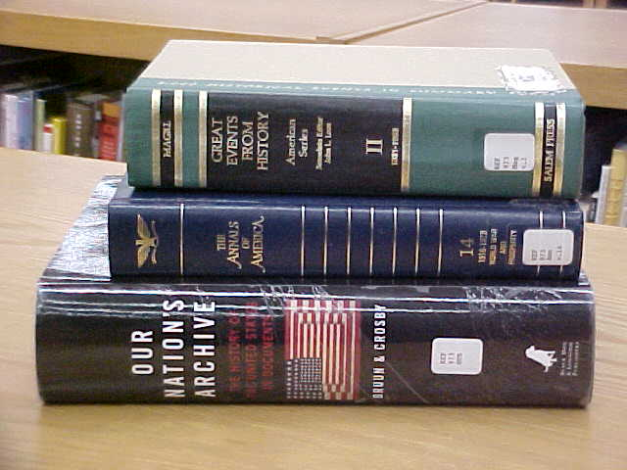
Secondary Sources
Books
Articles
Internet resources
Experts on the topic
  A secondary source is an account of the past created by people writing about events sometime after they happened.
Notes:
27

Slide 28
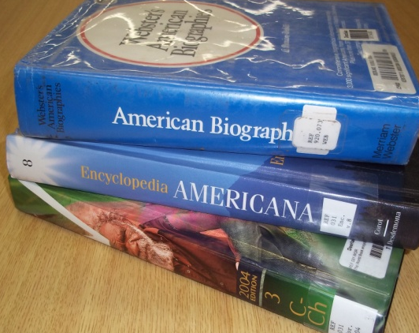
Tertiary Sources
Tertiary sources are based on a collection of primary and secondary sources and may or may not be written by an expert.
Tertiary sources should never appear in your bibliography!
They are only used as exploratory sources, to give you ideas about what to research.
Examples: dictionaries,
encyclopedias, fact books,
and guidebooks.
Wikipedia is not a reliable source and should not be utilized or appear in your bibliography!

Slide 29
As you read, WRITE things down!
To be a responsible researcher, you MUST give credit to your source of information in a bibliography.
It is important to collect the critical information from every source you plan to use:
  Author’s name, titles, publishers, date of publication, and page number for quotes.
Use research note pages!
Notes:
29

Slide 30
Plagiarism
Plagiarism — to present the ideas or words of another as one’s own.
Cheating — to practice fraud or deception; to behave dishonestly.

Slide 31
Examples of Plagiarism/Cheating
Buying or downloading a pre-written essay online and turning it in as your own.
Turning in another student’s work as your own.
Copying any portion of another person’s work without acknowledgement or permission.

Slide 32
More Examples of Plagiarism/Cheating
Paraphrasing (put into your own words) ideas from a source but not citing source.
Copying material from a source but not putting that information in quotation marks.
Cutting/pasting from websites and presenting it as your own work.
Forging your parent/guardian’s signature.

Slide 33
Consequences of Plagiarism:
Your parents will be notified.
You will fail your History Fair project.
You will receive a written referral to the Academic Dean.

Slide 34

This is your time to shine!
Do your OWN work and be proud of it!

